Slide 1
MeasureMate
LUCKY LADS
SHAURYA SRINET SHOUNAK CHANDRA CHARVI JAIN ANANYA KANNAN

Slide 2
Problem Statement
Innovative Wall Scanning: Detect and scan wall surfaces using AR Foundation.
Accurate Measurement Tools: Utilize a ruler algorithm to measure distances on scanned walls.
Furniture Distance Measurement: Easily measure the distance between two pieces of furniture.
Comprehensive Motion Capture: Record device movement with accelerometer and gyroscope data for more precise measurements

Slide 3
What do we offer to users?
Wall Scanning: Detects and scans wall surfaces accurately.
Measurement Tool: Using a precise ruler algorithm, measure distances on the scanned wall.
Furniture Distance Measurement: Measures distances between furniture pieces easily.
Motion Capture: Records and displays device movement data using built-in sensors.

Slide 4
Tech Stacks
AR Foundations
AR Core
Android
Development
C#
Unity &
Unity Hub
Git

Slide 5
Solution's X-factor
Augmented Reality Integration
Precision and Accuracy
User-Friendly Interface
Versatile Measurement Capabilities
Real-time Motion Capture

Slide 6
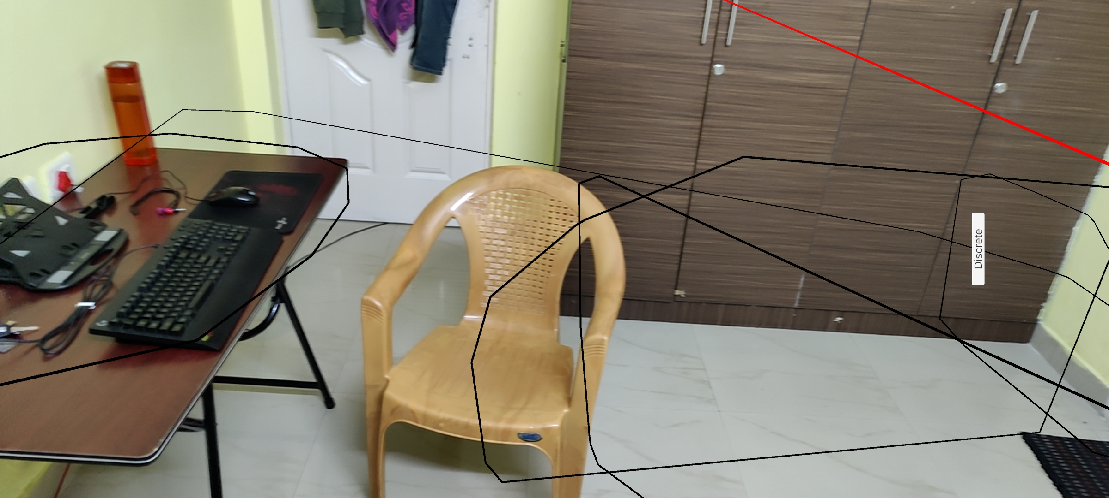
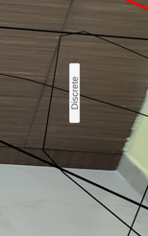
MeasureMate Simulation

Slide 7
Future Upgrades
AI-powered Integration
Improve Spatial Sound
NFTs Integration
Establishing virtual stores
Hyper-realistic Avatars

Slide 8
Risks
Technical Constraints
Privacy
Risks
User Experience Variation

Slide 9
Dependencies
Technical dependence
User involvement
Developer Community

Slide 10
Thank You

